Slide 1

TM112
Problem solving in Python
Introduction to
Computing & IT 2

Slide 2
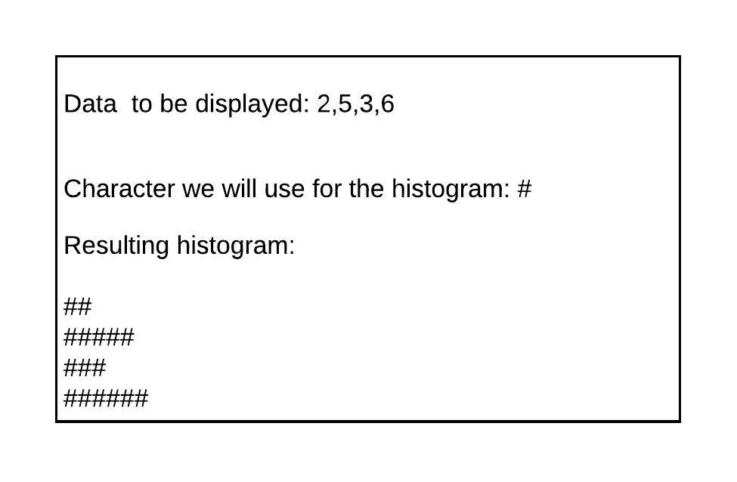
Problem 1 - a simple histogram
A histogram is a simple bar chart representing data pictorially.
We can create a simple bar chart by repeating characters.
If I were to give you the numbers 2,5,3,6 then a histogram for those numbers could look like this:
How would you write a program to do this?

Slide 3
Problem 1 - solution
Break the problem down into steps:
Problem: given a list of numbers draw a histogram for each number
> Repeat for each member of the list
> Draw a histogram line
>> set length to list item
>> set line to ‘’
>> repeat length times
>> add ‘#’ to line
>> print line

Slide 4
Problem 1 – into code
for n in [2,5,3,6]:
output = ''
times = n
while( times > 0 ):
output += '#'
times -= 1
print(output)

Slide 5
Problem 2 - a simple calculation
Body Mass Index is a measure of how overweight a person is.
It is calculated by getting the ratio of weight to height squared
BMI falls into 1 of 4 ranges
< 18 .5 - Underweight
18.5 – 24.9 Normal
25.0 – 29.9 Overweight
> 30 Obese
Write a program that takes the height and weight of a person, calculates the BMI and then reports on their range, i.e. it would report 21.3 Normal

Slide 6
Problem 2 - solution
Break the problem down into steps:
Problem: Calculate and report on a BMI given weight and height
> Get the persons weight in kg
> Get the persons height in m
> Calculate the BMI
BMI = round (Weight / (Height * Height), 2)
> Determine the range
> Print the BMI and range.

Slide 7
Problem 2 - solution
Refine the range evaluation:
> Determine the range
>> If the BMI is less than 18.5 set the range to underweight
>> If the BMI is more than 18.5 but less than 25 set the range to normal
>> If the BMI is more than 25 but less than 30 set the range to overweight
>> If the BMI is more than 30 set the range to obese
> Print the BMI and range.

Slide 8
Problem 2 – into code
Height = float(input ("Enter the height in m : "))
Weight = float(input ("Enter the weight in kg : "))
BMI = round (Weight / (Height * Height), 2)
if BMI < 18.5:
Range = "Underweight "
elif BMI >= 18.5 and BMI < 25:
Range = "Normal"
elif BMI >= 25 and BMI < 30:
Range = "Overweight "
else:
Range = "Obese "
print ("BMI = ", BMI, Range)

Slide 9
More resources
w3resource Python
https://www.w3resource.com/python/python-tutorial.php
Practice Python
https://www.w3resource.com/python/python-tutorial.php
Python Cheat Sheet (examples of commands)
https://github.com/ehmatthes/pcc/releases/download/v1.0.0/beginners_python_cheat_sheet_pcc_all.pdf

